Slide 1
Algorithmic and High-Frequency Trading Big & Alternative Data
Ken Liu

Slide 2

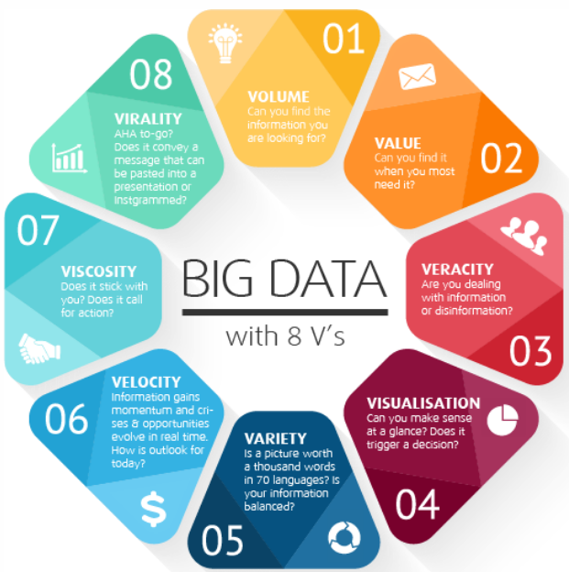

Big & Alternative Data

Slide 3
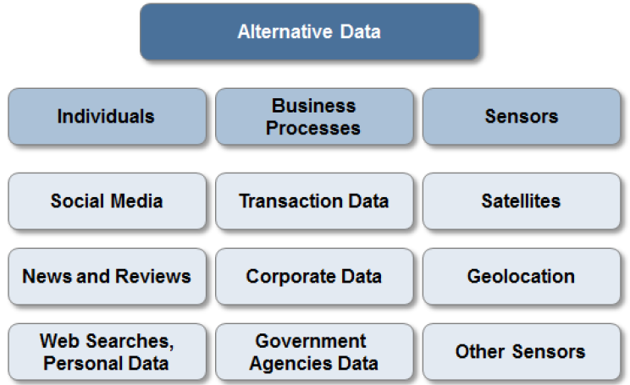
Data, Data, Data….

Slide 4
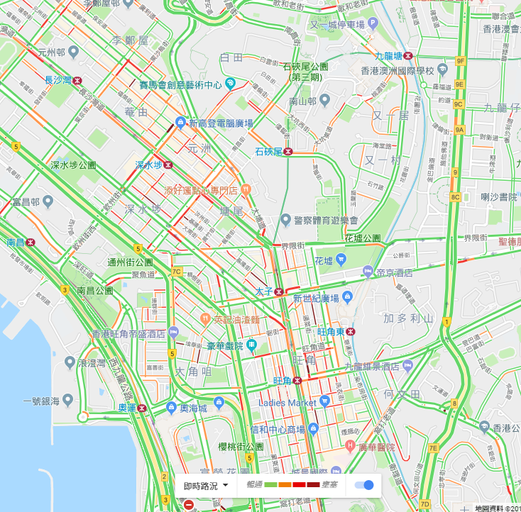
Individuals: Digital Footprints
How Google knows the traffic ?
1. From HK Transport Department ?
2. From Satellite Images ?
3. From You ?
Analyzing the GPS locations transmitted to Google by a large number of mobile phone users. By calculating the speed of users along a length of road, Google is able to generate a live traffic map
An Artist Used 99 Phones to Fake a Google Maps Traffic Jam

Slide 5
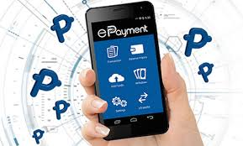
Business Processes
Commercial transactions (including e-commerce such as AliPay and WeChat, credit card spending, exchange transaction data)
Private agencies (e.g. industry specific supply chain data, intra-day tick data from the exchange)
Other ideas:
Amazon: track the best sales products and break down the underlying raw material for investing
Mobile payment transaction used for in credit risk modelling

Slide 6
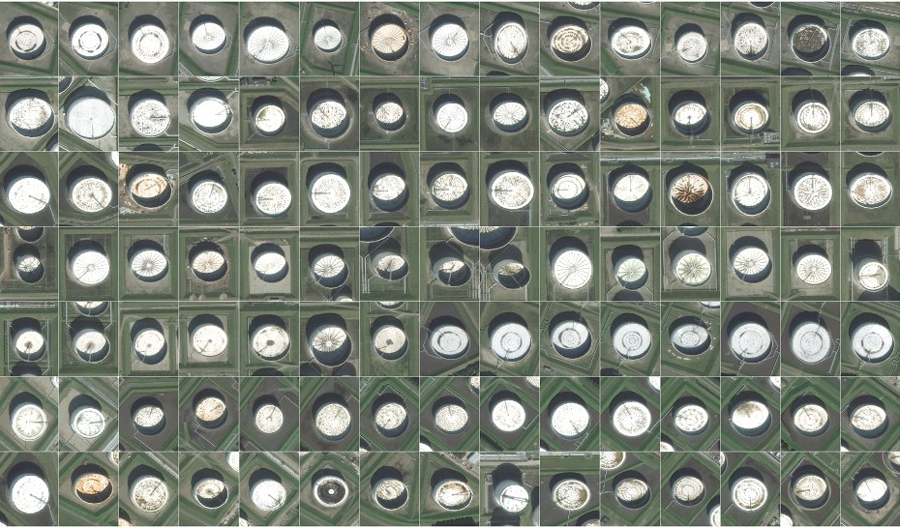
Satellite image: Oil Reserve
Oil reserves are often stored in floating tanks around the world, whose lid rises and falls with increasing or decreasing storage. With the rising and falling height, the crescent-shaped shadows cast by the sun also change shape. By tracking these shape changes (Deep Learning - CNN), Orbital Insights predicts oil inventory levels. https://www.wired.com/2015/03/orbital-insight/

Slide 7
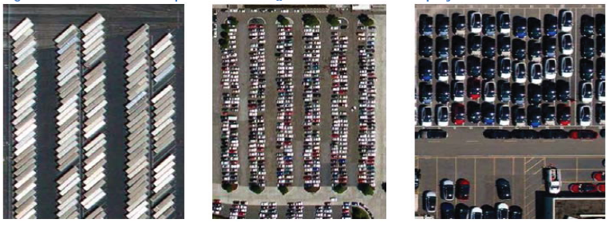
Satellite image: Parking Lots
Satellite Imagery of Parking Lots and Trading Retail Stocks from RS Metrics - uses ~10 high-resolution satellites, orbiting the Earth and imaging between the store opening hours. Such data can be used to estimate retail traffic (e.g. at some ~50 retail chains)
Other Ideas:
Road cameras (video) to gauge car brands popularity
In class students facial expressions to predict the class effectiveness

Slide 8
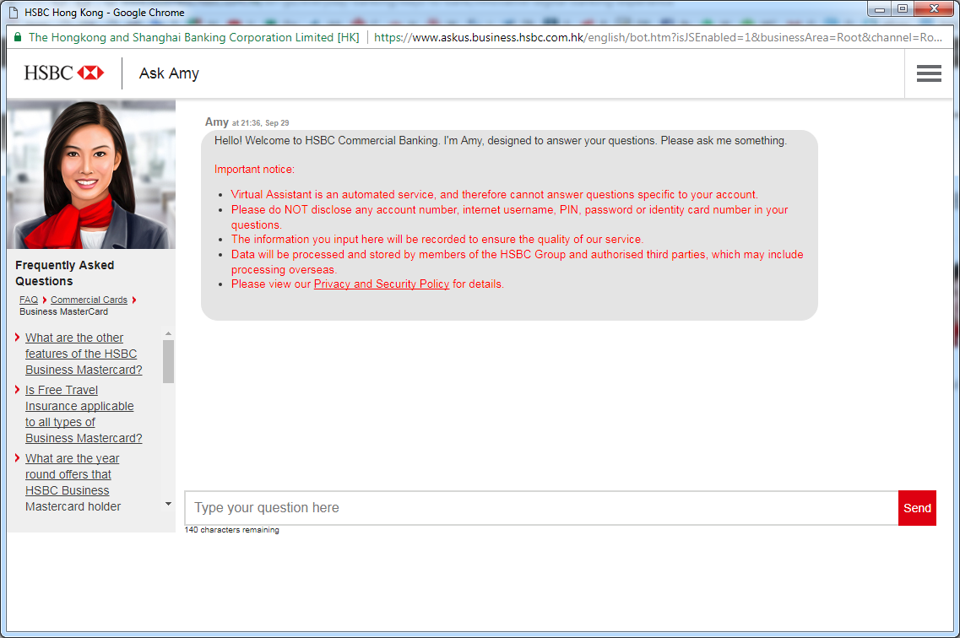
Example: HSBC Ask Amy Chatbot
Give it a try
use whatsapp to train chatbot
Revamp of 1823 Website with Chatbot Service, to facilitate the public to to access government information more directly and to answer simple enquiries
South Korean virtual girl iPhone app

Slide 9
Example: Amazon Alexa
Incoming customer call
Hi Nikki Wolf, based on unusual activity, we have locked your Credit Card. Is your call related to this? If so, please enter the onetime code sent to your phone.
Sure, the code is 12345.
Thank you. Your credit card is now unlocked and you should be able to proceed with the transaction.
Great, thank you!
CRM content
Data
Dip
DYNAMIC Amazon Connect answers customer questions before they are asked
PERSONAL Contact flows adapt on a per customer basis
NATURAL Connect integrates with Amazon Lex to give the apply speech recognition and natural language understanding technology that powers Alexa to customer interactions
Google Duplex helps to book restaurant
Voice Usage in TV program selection (e.g. myTVSuper)
HK Call Center -> GZ/Philippines -> Alexa/Siri

Slide 10
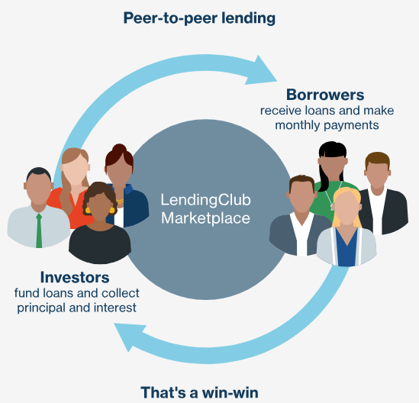
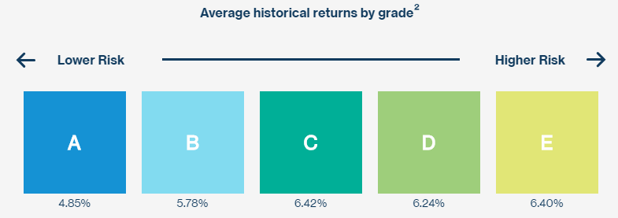
Example: P2P Lending
LendingClub. enables individuals to borrow and lend money without the use of an official financial institution as an intermediary
Monexo Lender

Slide 11
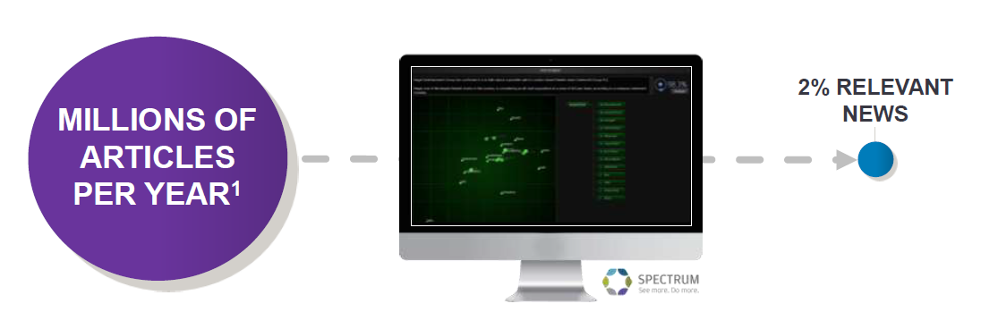
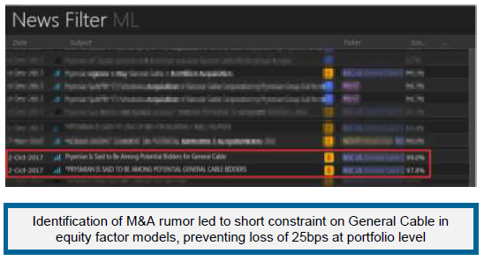
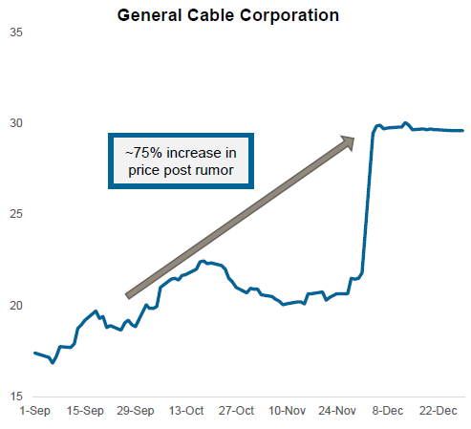
Example: News Filter
Source: J.P. Morgan Asset Management, Bloomberg

Slide 12
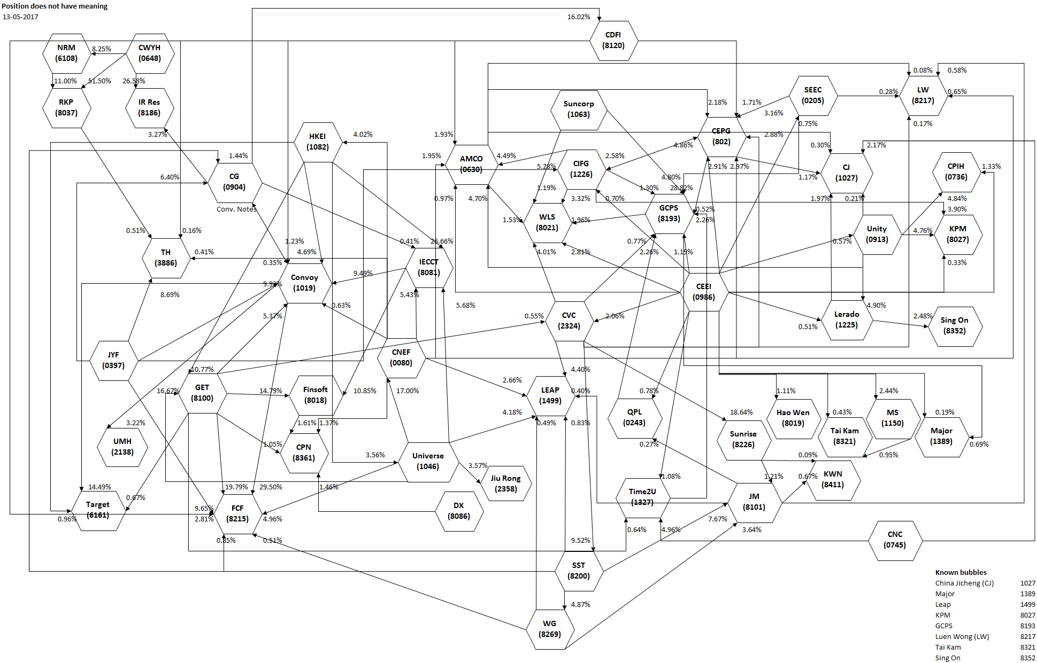
Example: Detect Unusual Trading Activity
The Enigma Network: 50 stocks not to own (David Webb)

Slide 13
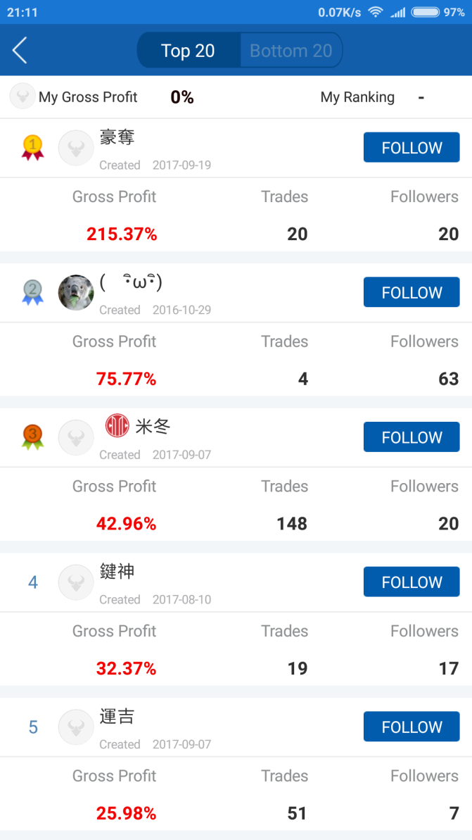

Example: Social Trading
Learn user trading patterns and behaviors
Money-making users can get paid for viewing their profitable portfolios and transaction notifications

Slide 14
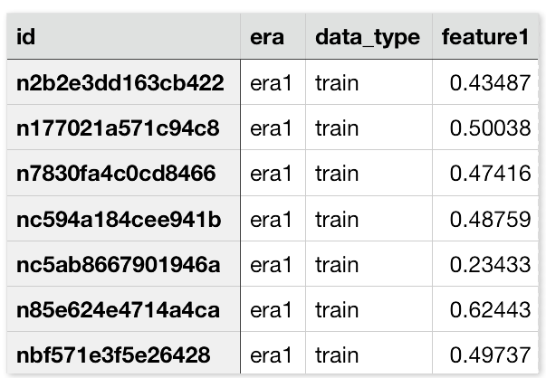
Example: Social Trading
Numer.ai: https://numer.ai/learn
No data scientist has a machine learning model that is better than all the others
Not a search for the ‘best’ model; it is a platform to synthesize many different models with many different characteristics
Collaboration to build the meta model
Reward with cryptocurrency

Slide 15
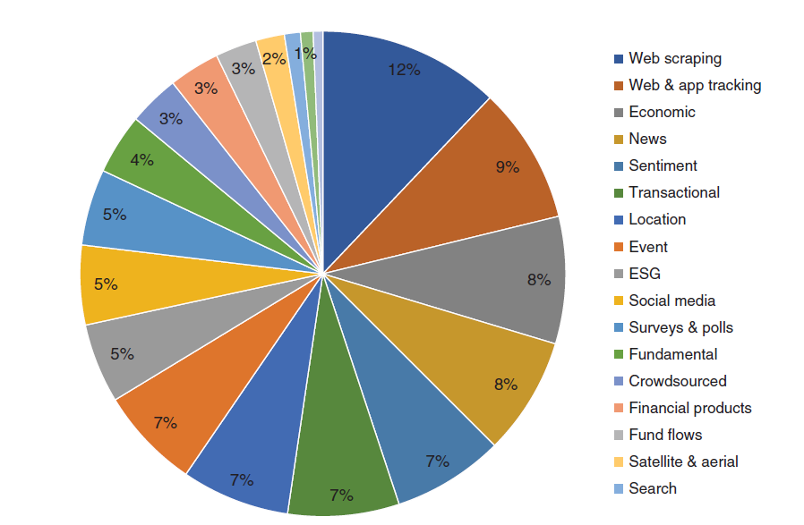
Alternative Data Breakdown
Breakdown of alternative data sources used by the buy side. Source: Neudata

Slide 16
Alternative Data Evaluation
Factor | Description
Data history length | The earliest point from which historical point in time data is available
Data frequency | The frequency with which data can be delivered
Universe coverage | How many investable companies the dataset relates to
Market obscurity | How well-known this dataset is to institutional Investors
Crowding factor | How many hedge funds and asset management clients are using this dataset
Uniqueness | How unique this specific dataset
Data quality | Completeness, structure, accuracy and timeliness of data
Annual price | Annual subscription price charged by the data provider

Slide 17
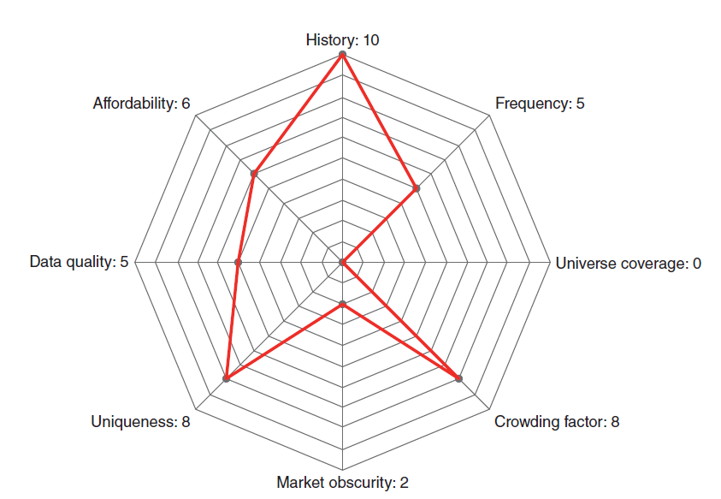
Alternative Data Evaluation
Satellite imagery tracking economic activity in China. A manufacturing index based on images of around 6000 industrial sites across covering 500,000 square km.
Data points delivered three times per week with a two-week delay. History is available from 2004
Index claims better than the Chinese Purchasing Managers Index (PMI), as it is questioned for a lack of accuracy and reliability.
In 2017, has four clients receiving the same underlying data. In 2018, mapping specific industrial sites to underlying companies
China manufacturing dataset. Source: Neudata.

Slide 18
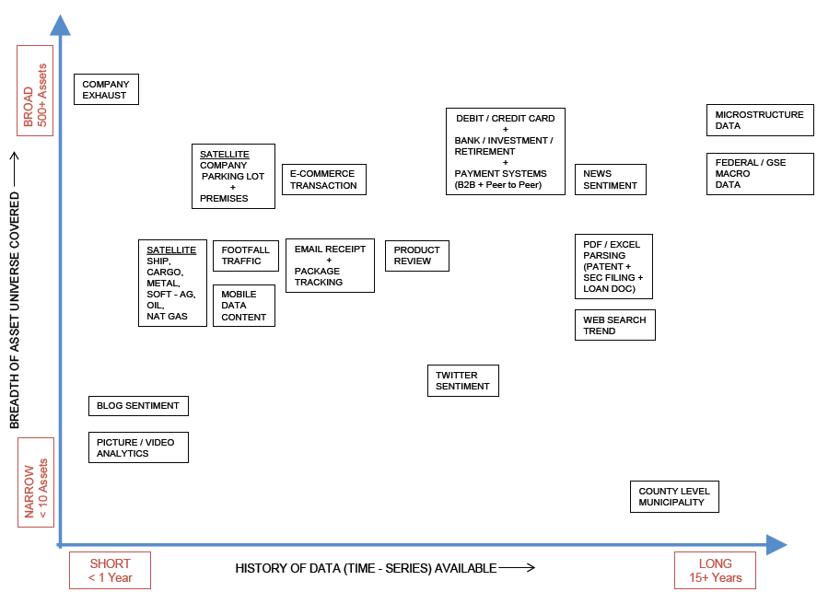
Alternative Data Summary
Alternative Dataset Providers

Slide 19
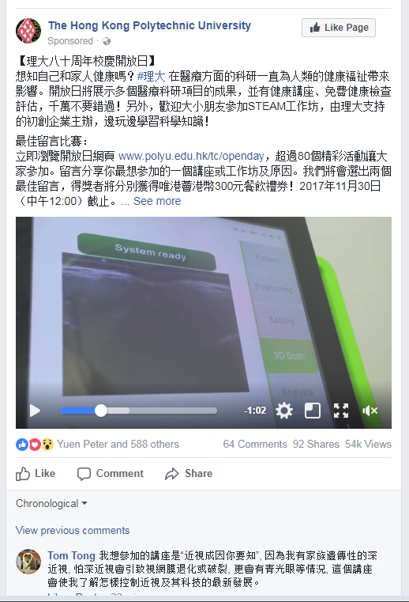
Datatact: Intro
Social Media Big Data Analytics
Fan Pages (1K +)
Posts (2.7M +)
Comments (35M +)
Reactions - Like, Love, Haha, Angry, Wow, Sad (50M +)
Shares (5M +)
Date: from 2009 to 2018-4 (Cambridge Analytica Scandal)
Co-founder’s Project

Slide 20
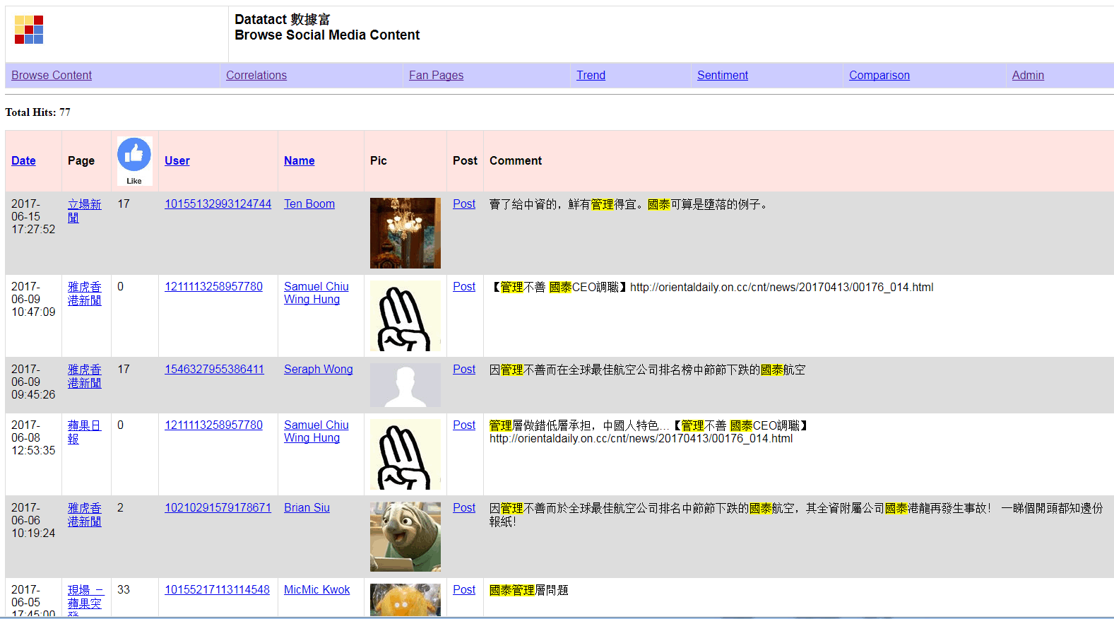
Datatact : Social Listening
Public images of Cathay Pacific
2017/07/12

Slide 21
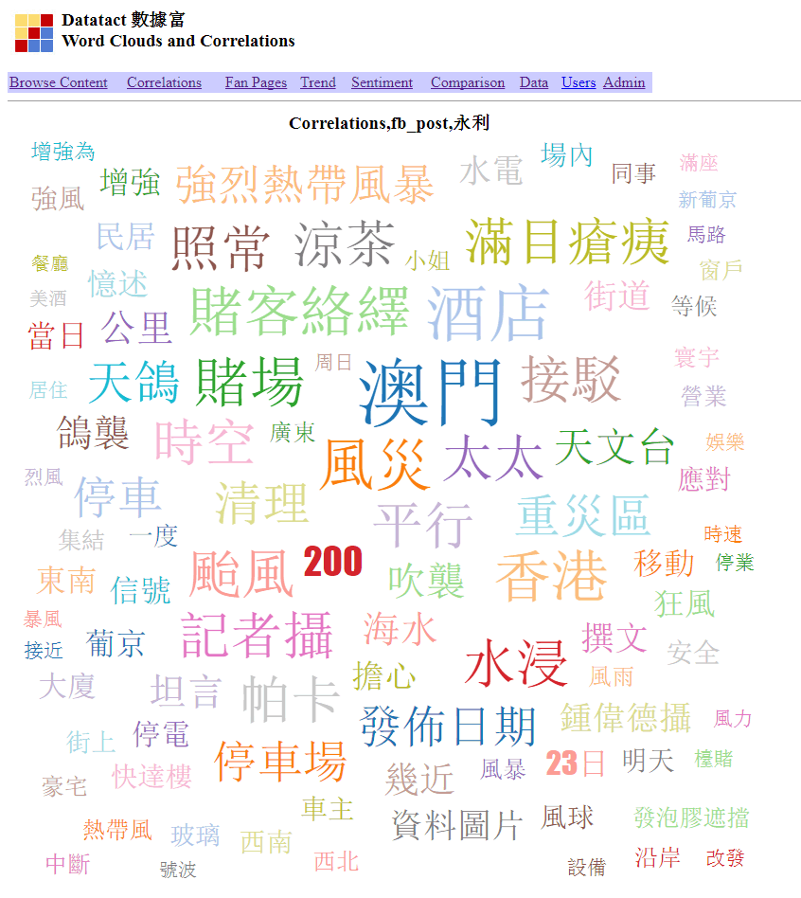
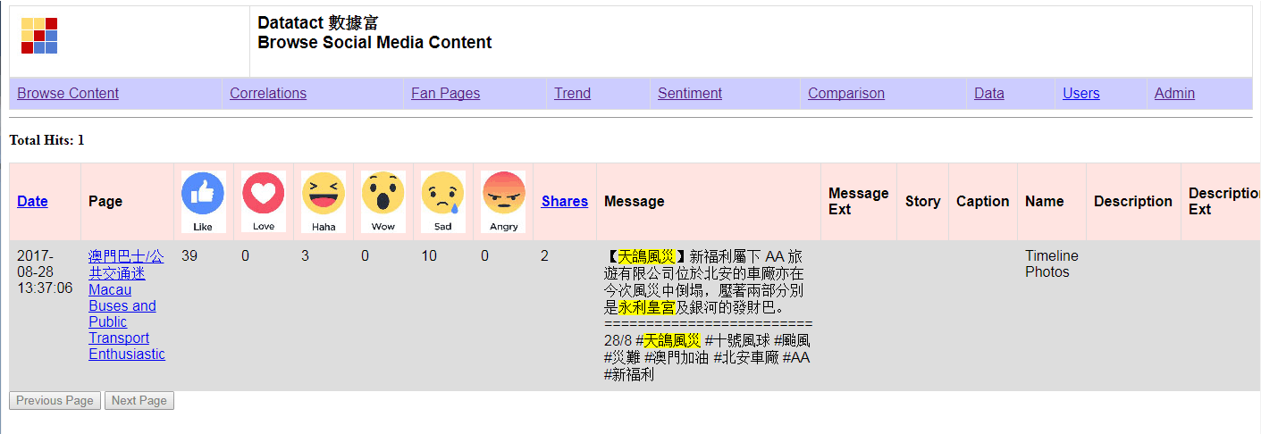
Datatact : Social Listening
Impact of Hato Typhoon to Macau Casinos (Wynn)
2017/08/30

Slide 22


Datatact : Content Farm
Generate large amounts of textual content to satisfy algorithms for maximal retrieval by automated search engines or to generate advertising revenue through attracting reader page views

Slide 23
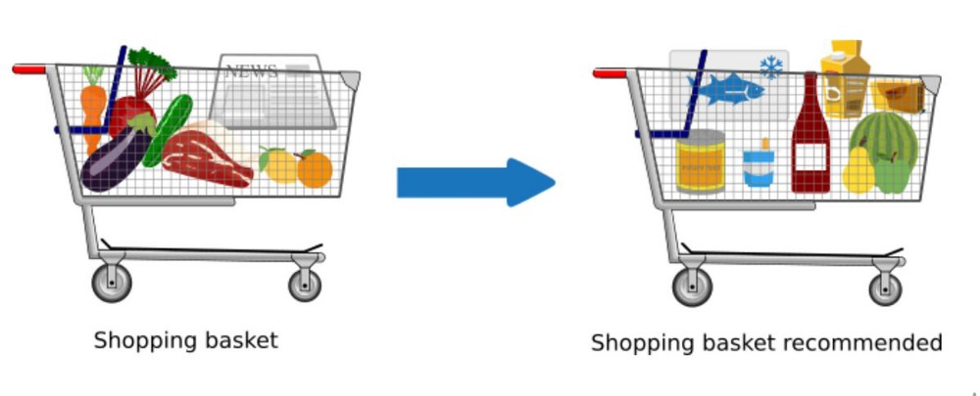
Datatact : Product Cross-selling
Market Basket: identifies the strength of association between pairs of products purchased together and identify patterns of co-occurrence.
Apriori: https://www.youtube.com/watch?v=TcUlzuQ27iQ
FP-Growth: https://www.youtube.com/watch?v=vPcJEFFWN_k&t=18s

Slide 24

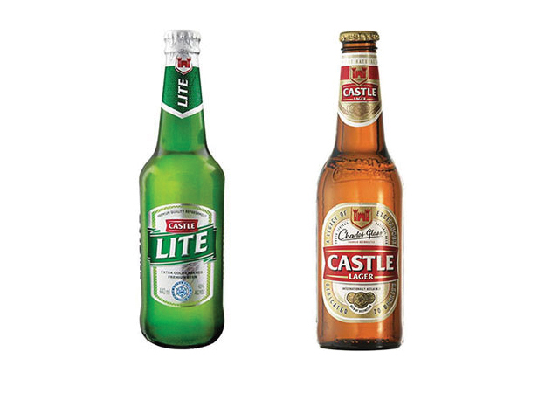
Datatact : Product Cross-selling
Supermarket Diaper & Beer Story

Slide 25




Datatact : Product Cross-selling
Datatact Example on Beauty Fan Pages

Slide 26

Datatact : Challenges
It’s important to understand how the end user uses the product

Slide 27

Datatact : Challenges
Nice to have but not critical. Hence many customers ask for prototype but no one really put down real money
Data analytics is free or at very low cost (just as software is free) as it’s not a tangible thing
Look for actions or real results (not data)

Slide 28
Development Pipelines
Facebook & Web Data Extraction (Code Example)
Storage (Database)
Pre-process: Cleaning, Small Caps, Tokenize, Remove StopWord, Word Stemming etc
Index
Search Query
Relevance and Sorting
Visualization & Interpretation

Slide 29
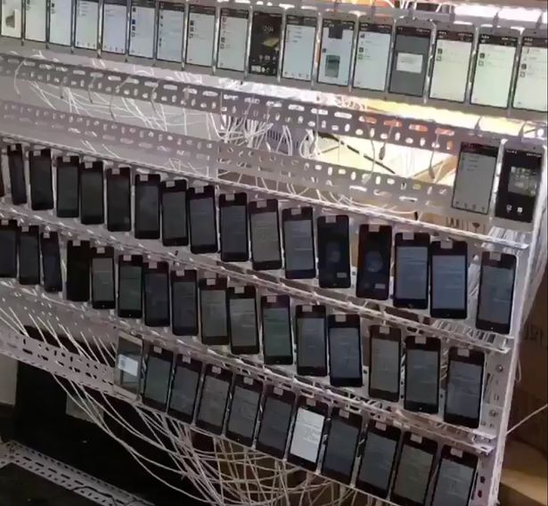
Data Extraction & Storage
Data Extraction
Manage Facebook account
Disconnect and retry
Throttling
Web Scraping
Privacy limitation (Cambridge Analytica Scandal: Facebook Allowed Firm To Exploit Data To Target American Voters)
Storage
Durable
Handle concurrency (multiple writer)
Fast retrieval

Slide 30
Pre Process
Cleaning
Remove symbols (, [ ] \ ! # etc)
Remove URLs
Tokenize
Break the sentence into words
English is easy but Chinese is not
Example:
各位父母買零食要留意
各位 父母 買零食 要 留意 (with space between each phrases)

Slide 31
Pre Process
Remove Stop Word
English: a an the
Chinese: 的 了 嗎
Small Caps
Convert all English letters to small caps
Word Stemming
English: stems stemmer stemming stemmed
Chinese: 香港大學, 港大, hku
Code Example

Slide 32
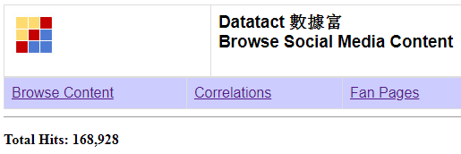
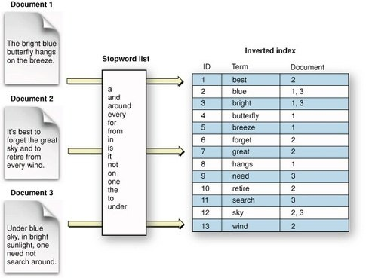
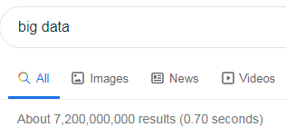
Searching
Inverted Index

Slide 33
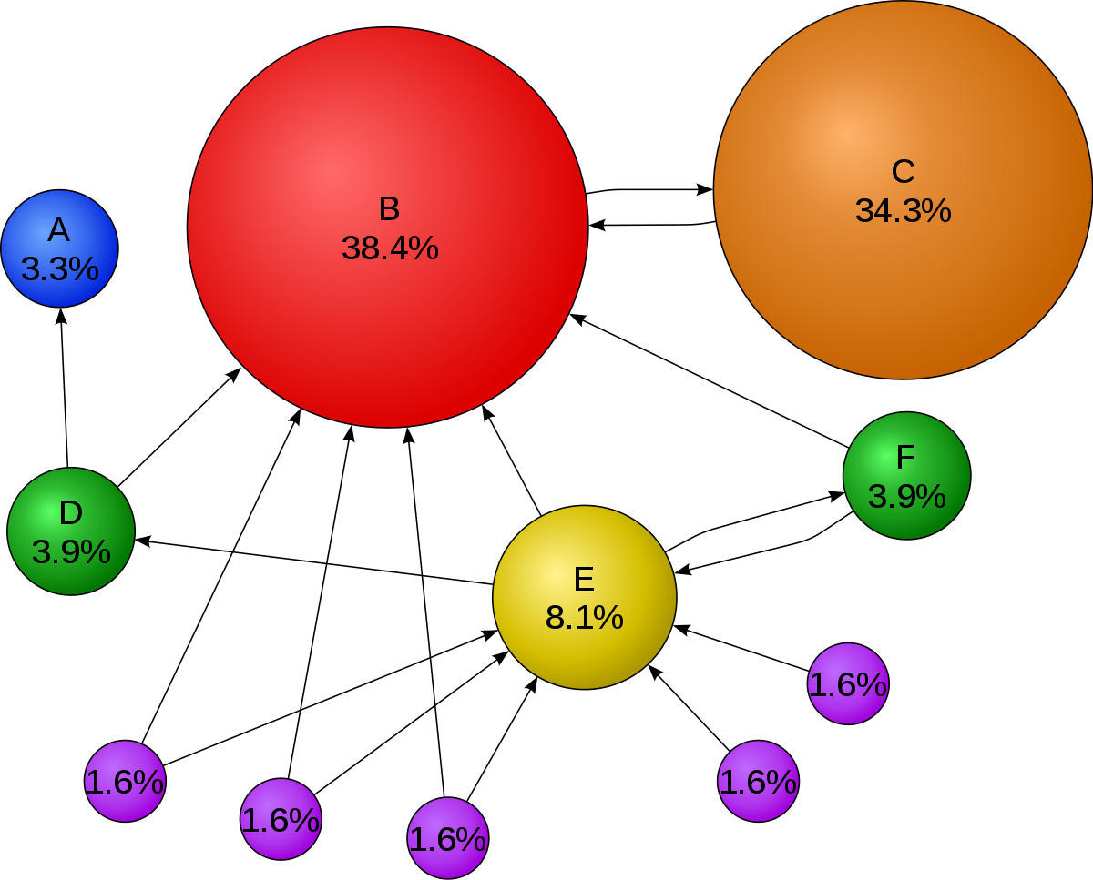
Ranking
How to rank and display the top 10 from the 1millions matched results?
Google realized that relevance for the web depended on trust, not just text
Trust is calculated by counting “weighted” back-links Each link is like a vote or endorsement (PageRank Algorithm)

Slide 34
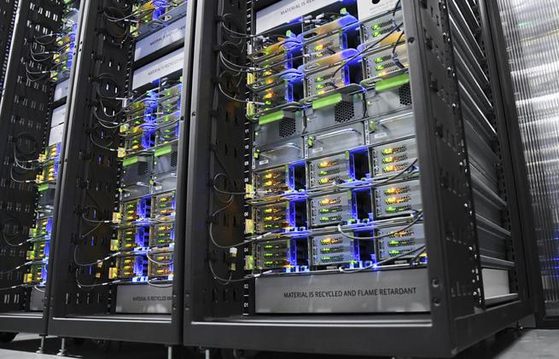
Google PageRank
What’s the biggest challenge to make PageRank accurate?
In order to count the back-links, needs to know all the links from the other web sites. Hence Google stores (caches) entire Web by Crawlers or Spiders in the data centers. Similar to Google Map, it is another application of Big Data to derive useful information

Slide 35
Social Media Ranking
Sort by Date
Sort by
Sort by Popularity Index
10*comment + 5*Love + 5*Angry + 4*Sad + 3*wow + 3*haha + 2*Comment_like + Page_like

Slide 36
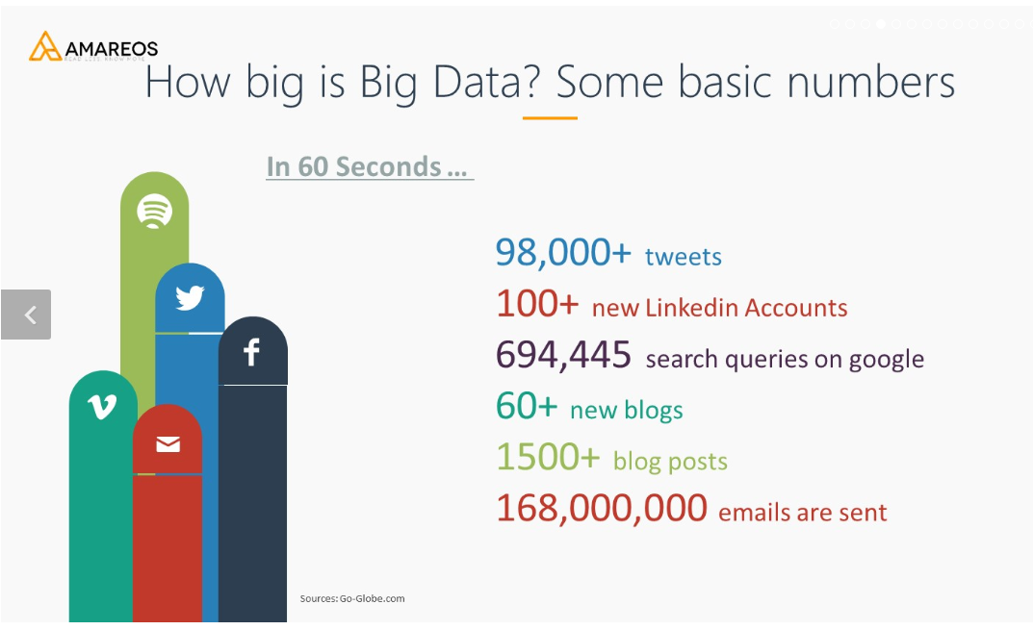
Big Data

Slide 37
Big Data
What exactly is Big Data (technically)
How big is big?
One possible answer: one computer cannot store all the required data now or in the foreseeable future (i.e. the data growth rate is fast)
Moving “big” data around the network is extremely slow

Slide 38
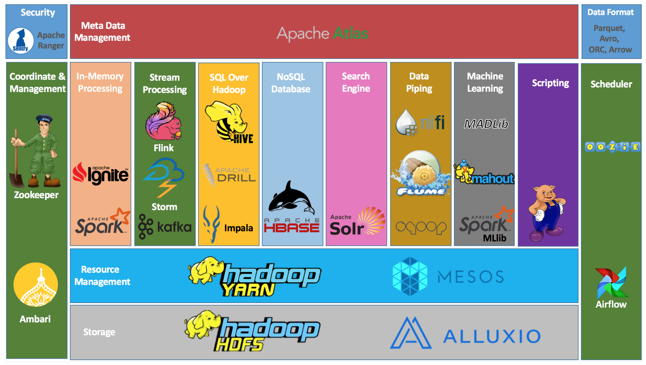
Key Technologies - Hadoop

Slide 39
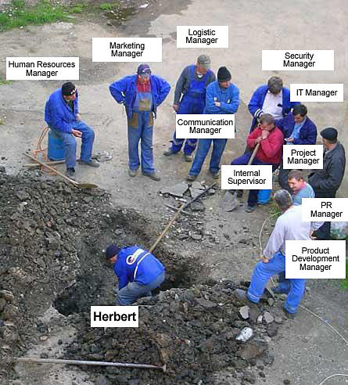
Map-Reduce - Data Parallelism
When you have many data and many computers, what’s the best way to work on it?

Slide 40
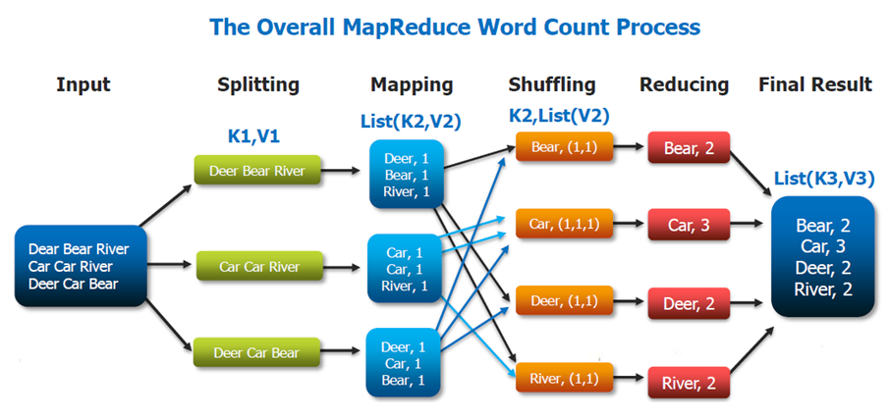
Map-Reduce - Data Parallelism
Moving the program to the data (rather than data to the program)
Split the task, compute sub results and combine them back for final result

Slide 41
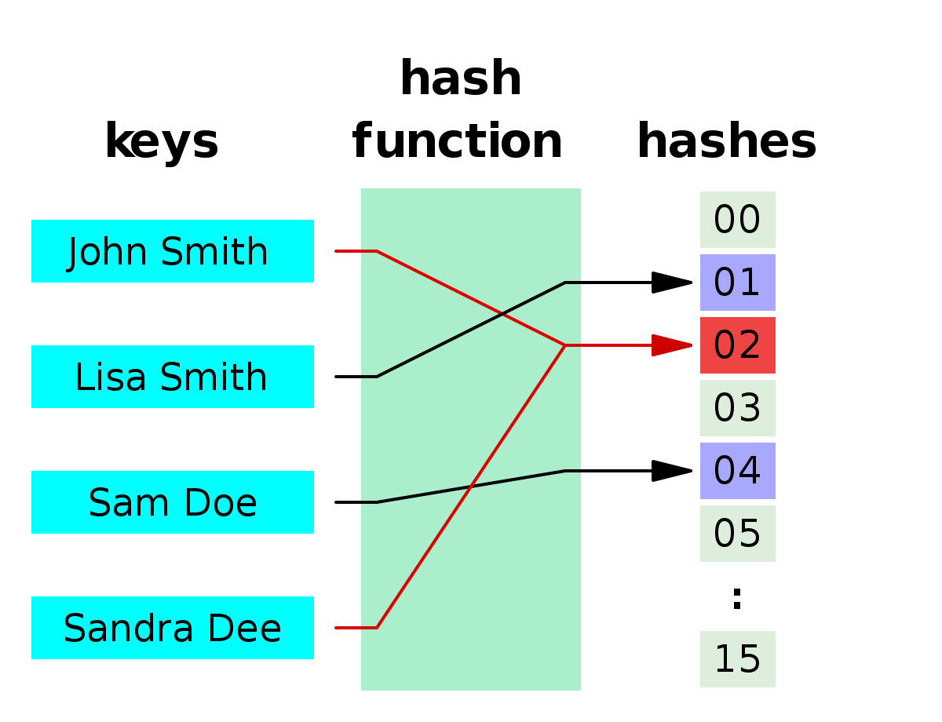
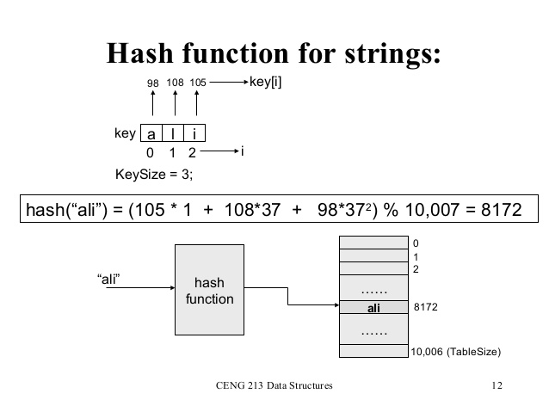
Hashing - Indexed by Calculation
One computer cannot host all the data and need to distribute into multiple computers (clusters of computers)
Hash function determine what data to store in which computer
h(x) = integer

Slide 42
Do you need Big Data Solution
Datatact Data Count
Facebook | Counts
Posts | 2.7M +
Comments | 35M +
Reactions (Like, Love Haha, Angry, Wow, Sad) | 50M +
Database size: 95.6 GB
Index size: 18.2 GB
Total: 113.8 GB

Slide 43
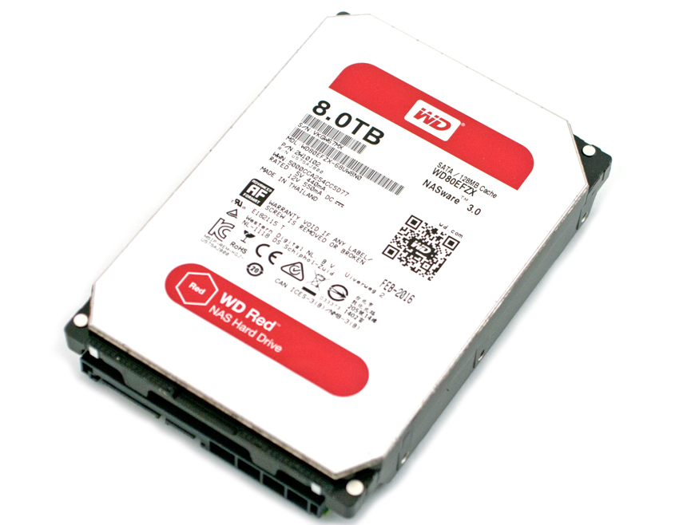
Do you need Big Data Solution
Western Digital Red Edition (NAS)
Capacity (TB) | HK$ | $/TB
1 | 470 | 470
2 | 500 | 250
3 | 699 | 233
4 | 790 | 198
6 | 1,225 | 204
8 | 1,450 | 181
Source: Central Field as of 2019/11/5

Slide 44
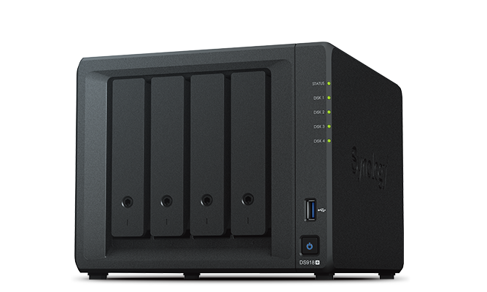
Do you need Big Data Solution
Synology DiskStation DS918+
4-Bay NAS: HK$ 3,900
4 x 8 TB = 32 TB: HK$ 5,800
Total = $ 9,700
Datatact 113.8 GB / 32 TB = ~0.36% ➔
281 years of linear growth or
15 years of 50% exponential growth

Slide 45

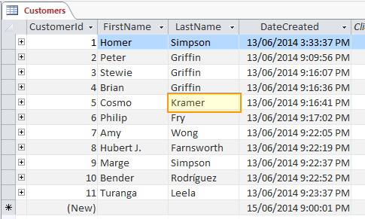

Do you need Big Data Solution
How Datatact stores the data
MySQL : traditional relational database
Apache Lucene: inverted index for fast data searching and ranking
No Big Data solution is required

Slide 46

Do you need Big Data Solution
Are you a data company ?
Is your data volume more than a single computer?
Is your data growing exponentially (internet scale) or faster than the growth of single-disk storage capacity?
Is your data mostly immutable (i.e. write once, read many times)?
>> If not, probably you don’t need Hadoop or the related Big Data tech

Slide 47
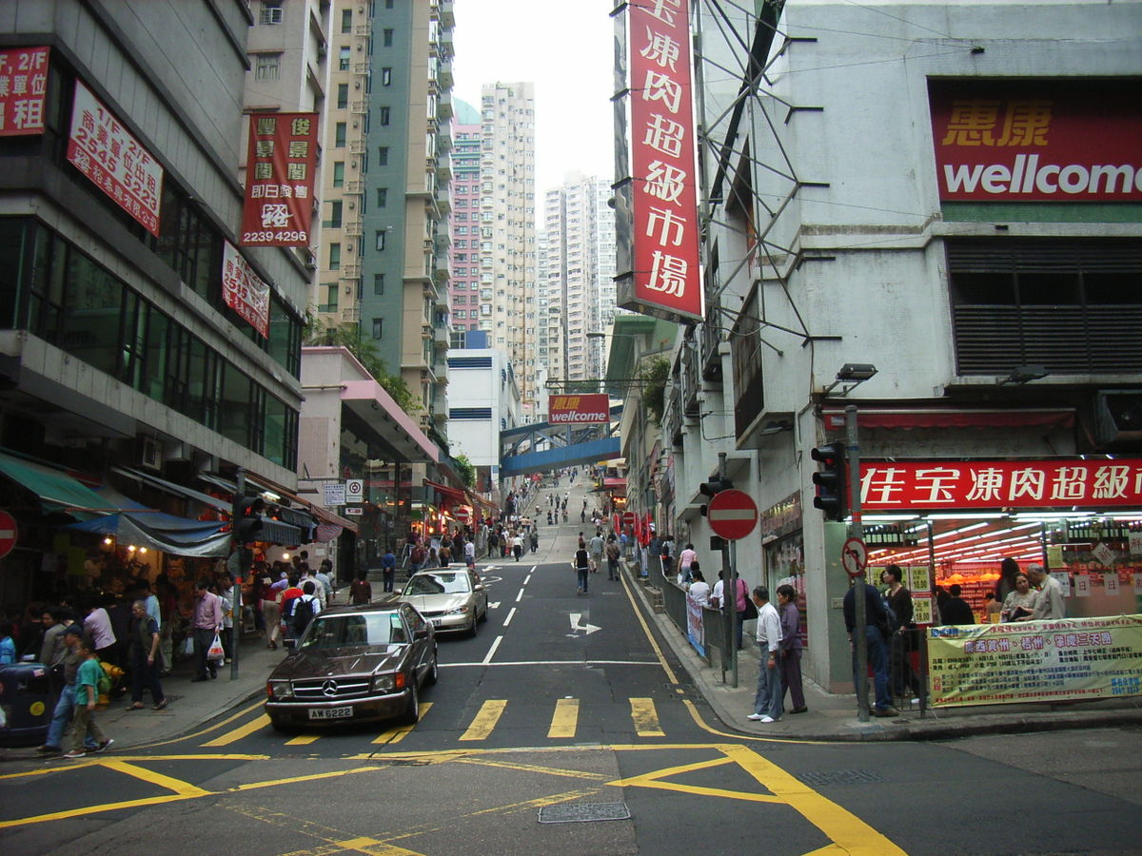

Do you need Big Data Solution
Because everyone is talking about Big Data, let’s use it as it sounds cool !

